Slide 1
Introduction to .Net Framework
Shijil Pannian

Slide 2
What is .Net
.Net is a new framework for developing web-based and windows-based applications within the Microsoft environment.
The framework offers a fundamental shift in Microsoft strategy: it moves application development from client-centric to server-centric

Slide 3
.Net
.NET Application
.NET Framework
Operating System + Hardware

Slide 4
Framework, Languages and Tools
VB
VC++
VC#
JScript
…
Visual Studio.NET
Common Language Specification
ASP.NET: Web Services
and Web Forms
Windows Forms
ADO.NET: Data and XML
Base Class Library
Common Language Runtime

Slide 5
Common Language Runtime (CLR)
CLR works like a virtual machine in executing all languages.
All .NET languages must obey the rules and standards imposed by CLR. Examples:
Object declaration, creation and use
Data types, language libraries
Error and exception handling
Interactive Development Environment (IDE)

Slide 6
CLR (cont…)
Development
Mixed language applications
Common Language Specification (CLS)
Common Type System (CTS)
Standard class framework
Automatic memory management
Consistent error handling and safer execution
Potentially multi-platform
Deployment
Removal of registration dependency
Safety – fewer versioning problems

Slide 7
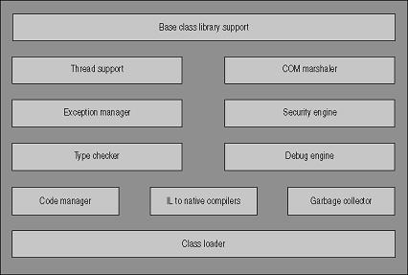
Architecture of CLR

Slide 8
Common Language Specification(CLS)
CLS is a fundamental set of language features supported by the CLR of the .NET Framework.
When there is a situation to communicate Objects written in different .Net Complaint languages , those objects must expose the features that are common to all the languages .
CLS ensures complete interoperability among applications, regardless of the language used to create the application.

Slide 9
Common Type System (CTS)
CTS is a standard for defining and using data types in the .NET framework.
CTS defines a collection of data types, which are used and managed by the run time to facilitate cross-language integration.
CTS supports two different kinds of types:
Value Types
Reference Types

Slide 10
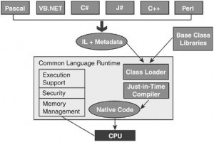
.Net Framework working process

Slide 11
Microsoft Intermediate Language (MSIL)
MSIL is a CPU-independent set of instructions that can be efficiently converted to the native code.
During the runtime CLR's Just In Time (JIT) compiler converts the MSIL code into native code to the Operating System.
When a compiler produces MSIL, it also produces Metadata. MSIL and Metadata are contained in a portable executable (PE) file .

Slide 12
Just In Time Compiler (JIT)
JIT stands for just-in-time compiler. It converts the MSIL code to CPU native code as it is needed during code execution. It is called just-in-time since it converts the MSIL code to CPU native code; when it is required within code execution otherwise it will not do nothing with that MSIL code.
Types
Normal JIT
Econo JIT
Pre JIT

Slide 13
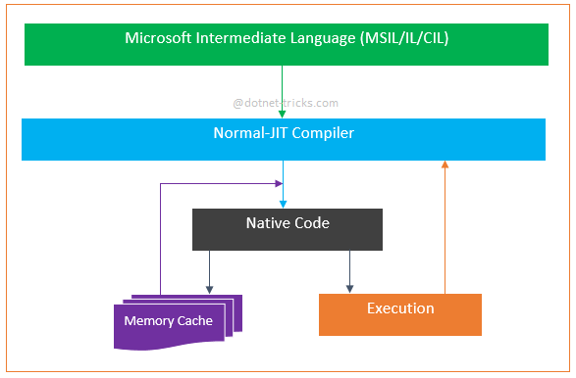
JIT (cont…)
Normal JIT
This complies only those methods that are called at runtime. These methods are compiled only first time when they are called, and then they are stored in memory cache. When the same methods are called again, the complied code from cache is used for execution.

Slide 14
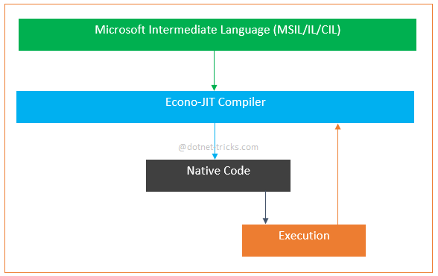
JIT (cont…)
Econo JIT
This complies only those methods that are called at runtime and removes them from memory after execution.

Slide 15
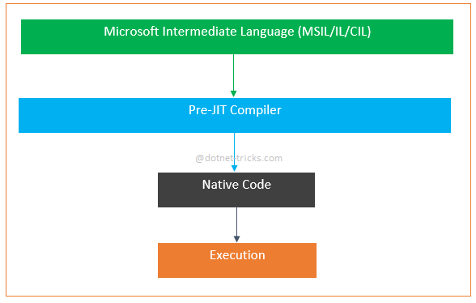
JIT (cont…)
Pre JIT
This complies entire MSIL code into native code in a single compilation cycle. This is done at the time of deployment of the application.

Slide 16
Base Class Library (BCL)
The .NET framework provides a set of base class libraries which provide functions and features which can be used with any programming language which implements .NET, such as Visual Basic, C# (or course), Visual C++, etc.
The base class library contains standard programming features such as Collections, XML, DataType definitions, IO ( for reading and writing to files), Reflection and Globalization to name a few.
All of which are contained in the System namespace.
Eg: System
System.Data
System.IO
System.Web
etc

Slide 17
Managed & Unmanaged Codes
Managed Code
The code, which is developed in .NET framework, is known as managed code. This code is directly executed by CLR with help of managed code execution. Any language that is written in .NET Framework is managed code.
Managed code uses CLR which in turns looks after your applications by managing memory, handling security, allowing cross - language debugging, and so on.
UnManaged Code
Applications that do not run under the control of the CLR are said to be unmanaged, and certain languages such as C++ can be used to write such applications, which, for example, access low - level functions of the operating system.

Slide 18
Garbage Collector
Garbage collector manages the allocation and release of memory for your application.
Enables you to develop your application without having to free memory.
Allocates objects on the managed heap efficiently.
Reclaims objects that are no longer being used, clears their memory, and keeps the memory available for future allocations.
Provides memory safety by making sure that an object cannot use the content of another object.

Slide 19
ASP.NET
ASP.NET,the platform services that allow to program Web Applications and Web Services in any .NET language
ASP.NET Uses .NET languages to generate HTML pages. HTML page is targeted to the capabilities of the requesting Browser
ASP.NET “Program” is compiled into a .NET class and cached the first time it is called. All subsequent calls use the cached version.

Slide 20
ASP.Net (Cont…)
Logical Evolution of ASP
Supports multiple languages
Improved performance
Control-based, event-driven execution model
More productive
Cleanly encapsulated functionality

Slide 21
Asp vs Asp.Net
Asp | Asp.Net
Running under the inetinfo.exe (IIS) process space. | Asp.net worker process (aspnet_wp.exe) separate from IIS process.
ASP is interpreted | ASP.NET is compiled
Performance impact | No performance impact
Debugging is difficult | Easy debugging
Use ADO to connect with database | Use ADO.net to connect with database
Mixed HTML and coding logic | Html and coding part are separated by code behind files.
Partially object oriented | Purely object oriented
No built in support for xml. | Full xml support for easy data exchange.

Slide 22


Questions

Slide 23
THANKS

